Slide 1

Title of the Project:
2-Port Microstrip MIMO Antenna
NAME OF PROJECT SUPERVISOR:
Mr. Rakesh Kumar
GROUP MEMBERS:
1. Snehil Jaiswal (2200910310164)
2. Shailendra Pratap Yadav (2200910310150)
3. Shantanu Sharma (2200910310152)
DEPARTMENT OF ELECTRONICS AND COMMUNICATION ENGINEERING

Slide 2
INDEX
Title of the Project
Problem Statement
Literature Survey
Objective
Methodology
Block Diagram
Antenna Design
Results
Comaprison Table
Conclusion
References

Slide 3
TITLE OF THE PROJECT
Design of 2-Port Microstrip MIMO Antenna for Sub-6 GHz 5G Applications

Slide 4
PROBLEM STATEMENT
Increasing demand for compact, efficient, and multiband antennas in modern high-speed wireless communication systems.
Conventional single-band antennas fail to operate efficiently across multiple bands and do not meet multi-standard communication needs.
In MIMO antenna configurations, closely spaced elements cause high mutual coupling, reducing system performance.
There is a need for a 2-port microstrip MIMO antenna offering high isolation, compact size, and reliable wideband performance.
The proposed antenna design is simulated and optimized using ANSYS HFSS to enhance bandwidth, isolation, and radiation characteristics.

Slide 5
LITERATURE SURVEY
The evolution of MIMO (Multiple Input Multiple Output) antenna systems has played a critical role in improving wireless channel capacity and reliability. Several research works have contributed to the development of multiband and compact MIMO antennas suitable for modern communication standards such as 4G, 5G, Wi-Fi, and WiMAX. The following review summarises relevant research contributions and identifies the research gaps that this project aims to address.
Ahmed, H.; Ameen, A.M.; Magdy, A.; Nasser, A.; Abo-Zahhad, M. A Sub-6GHz Two-Port Crescent MIMO Array Antenna for 5G Applications. Electronics 2025, 14, 411. https://doi.org/10.3390/ electronics14030411
P. Singh et al. (IEEE, 2022) developed a compact MIMO antenna with dual-band operation at 3.5 GHz and 5.8 GHz using a slotted patch design. The study demonstrated that introducing complementary split ring resonators (CSRR) significantly improved isolation and multiband operation without enlarging the antenna size.
R. Sharma et al. (IEEE Access, 2021) proposed a two-port antenna with a defected ground structure (DGS), which effectively suppressed surface currents leading to an isolation improvement of over 25 dB. The paper highlighted that DGS-based approaches can achieve superior performance with minimal complexity.
H. Pandey et al. (Microwave and Optical Tech. Letters, 2021) proposed a MIMO antenna with a compact ground-slot configuration suitable for IoT and vehicular communication.

Slide 6
4. M. Kumar et al. (IET Microwaves, 2020) designed a circular patch-based multiband antenna that
achieved stable radiation characteristics for WiMAX and WLAN bands. The design utilised slot
etching techniques and dielectric optimisation to maintain return loss below -20 dB across both bands.
5. A. Yadav et al. (IJAREEIE, 2020) presented a triple-band microstrip antenna incorporating parasitic
coupling, demonstrating how structural symmetry influences polarisation and impedance bandwidth.
6. B. Gupta et al. (IEEE Antennas & Propagation, 2019) explored multiple decoupling techniques,
including neutralisation lines and electromagnetic band-gap (EBG) structures, achieving enhanced
diversity gain.
These studies collectively indicate that hybrid approaches using DGS, slots, and decoupling networks offer the most promising performance for multiband applications.
Based on this literature, our project focuses on combining slot modification and optimized feed structure techniques in HFSS simulation to achieve performance between 3.2 GHz to 6 GHz. The design aims to minimize mutual coupling (< -20 dB) while maintaining high gain and compactness suitable for next-generation communication systems.

Slide 7
OBJECTIVES OF THE PROJECT
The objectives of the proposed project are both analytical and application-oriented, focusing on simulation-based performance optimisation. The following goals define the measurable deliverables and outcomes:
To simulate and validate the antenna using ANSYS HFSS, we analyse critical parameters such as return loss (S11), isolation (S12), VSWR, gain, and radiation efficiency.
To implement mutual coupling reduction techniques such as defected ground structures or decoupling slots to enhance isolation performance.
To optimise substrate parameters, patch geometry, and feed configuration for improved impedance matching and stable radiation patterns.
To evaluate performance metrics, including envelope correlation coefficient (ECC), diversity gain (DG), and total active reflection coefficient (TARC).
To compile simulation results into comparative graphs and tables demonstrating improvements over conventional designs.

Slide 8
METHODOLOGY (Workflow)
Initial Single-Port Antenna Design : Design a single microstrip patch antenna based on target Sub-6 GHz resonance.
Simulation of Single Patch in HFSS : Apply boundary conditions, excitation port, and run EM simulation.
Performance Evaluation : Analyse S₁₁, bandwidth, and gain to ensure resonance at the desired frequency.
Transition to MIMO Configuration : Convert single-element geometry into a 2-port layout while keeping compact dimensions.
Isolation & Coupling Analysis : Simulate and evaluate S₂₁/S₁₂, ECC, and radiation characteristics of the 2-port configuration.
Design Optimization : Introduce slot/DGS/spacing/structural modifications to improve bandwidth and mutual isolation.
Final Validation : Confirm performance targets: → S₁₁ < –10 dB, → S₂₁ < –15 or –20 dB, → Stable radiation pattern & ECC ≈ 0.
Documentation & Result Comparison : Compare final antenna performance with results from reference papers.

Slide 9
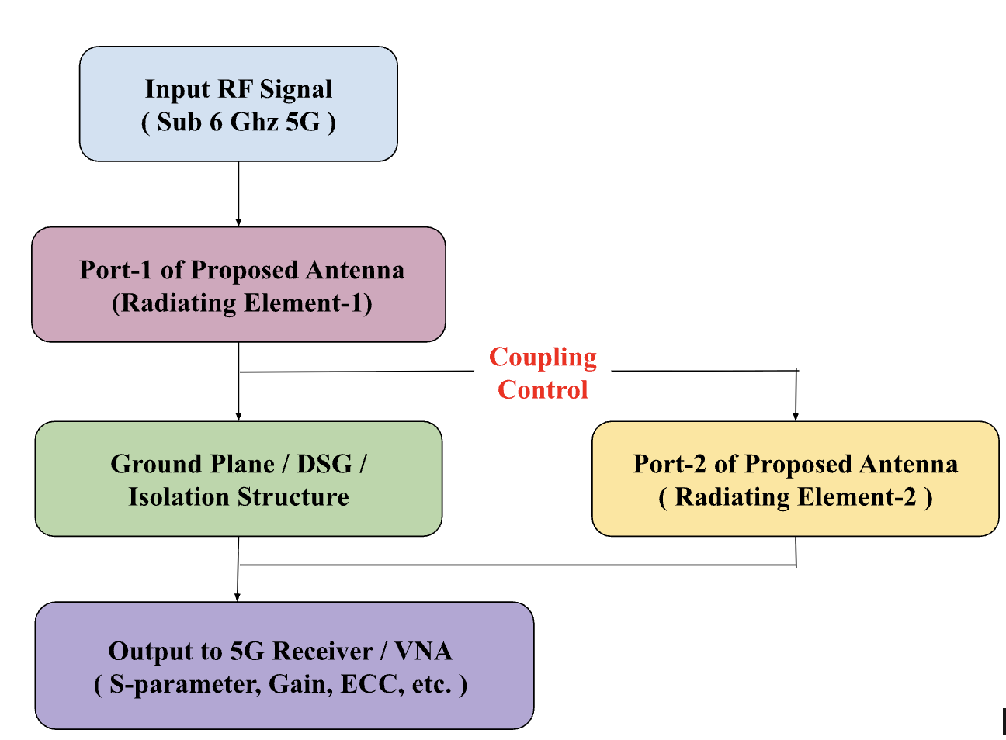
BLOCK DIAGRAM OF THE PROJECT
The block diagram below illustrates the overall workflow of the proposed antenna design and simulation process:

Slide 10
This block diagram represents the functional operation of the proposed two-port microstrip MIMO antenna for Sub-6 GHz 5G applications. A Sub-6 GHz RF signal is applied independently to both radiating ports of the antenna. The isolation and defected-ground/decoupling structure in the middle of the antenna suppress mutual coupling between the ports and maintains low envelope correlation. Each port radiates and receives electromagnetic energy independently, and the combined radiation characteristics enable MIMO spatial diversity. The antenna output is analyzed through a Vector Network Analyzer (VNA) or 5G transceiver for evaluation of S-parameters, gain, bandwidth, radiation patterns and ECC.

Slide 11
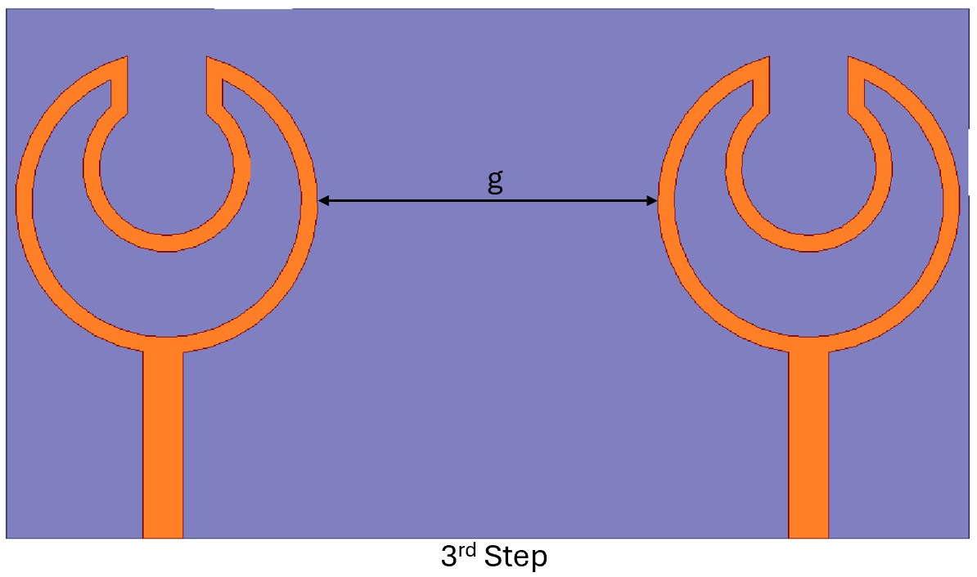
ANTENNA DESIGN
Front View

Slide 12
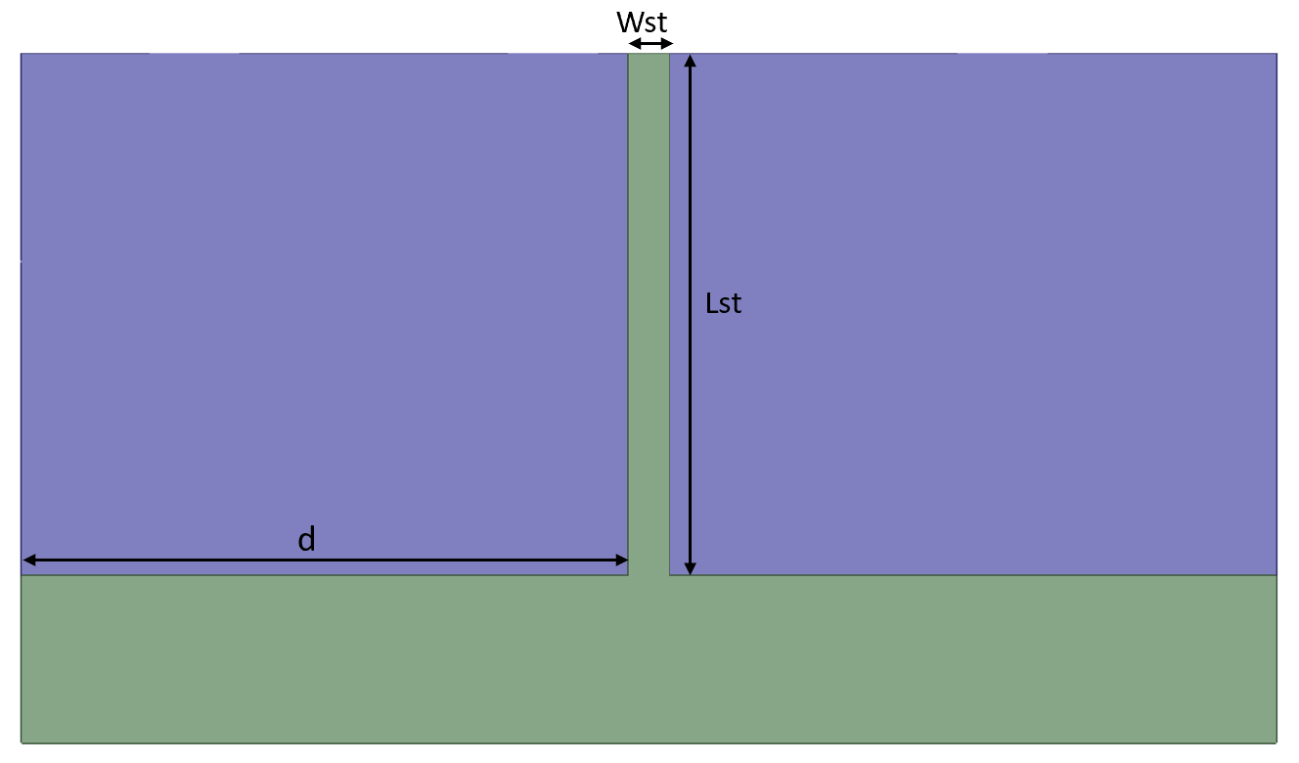
Back View

Slide 13
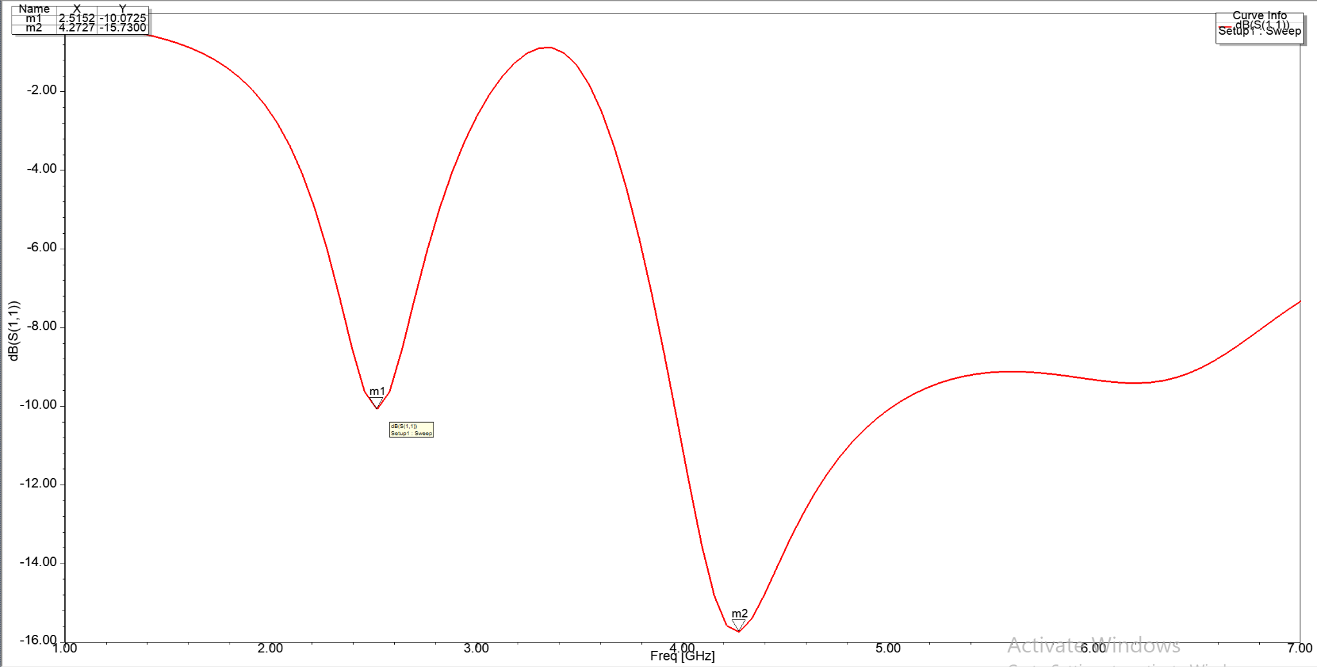
RESULTS
S11 Parameter for Single Element

Slide 14
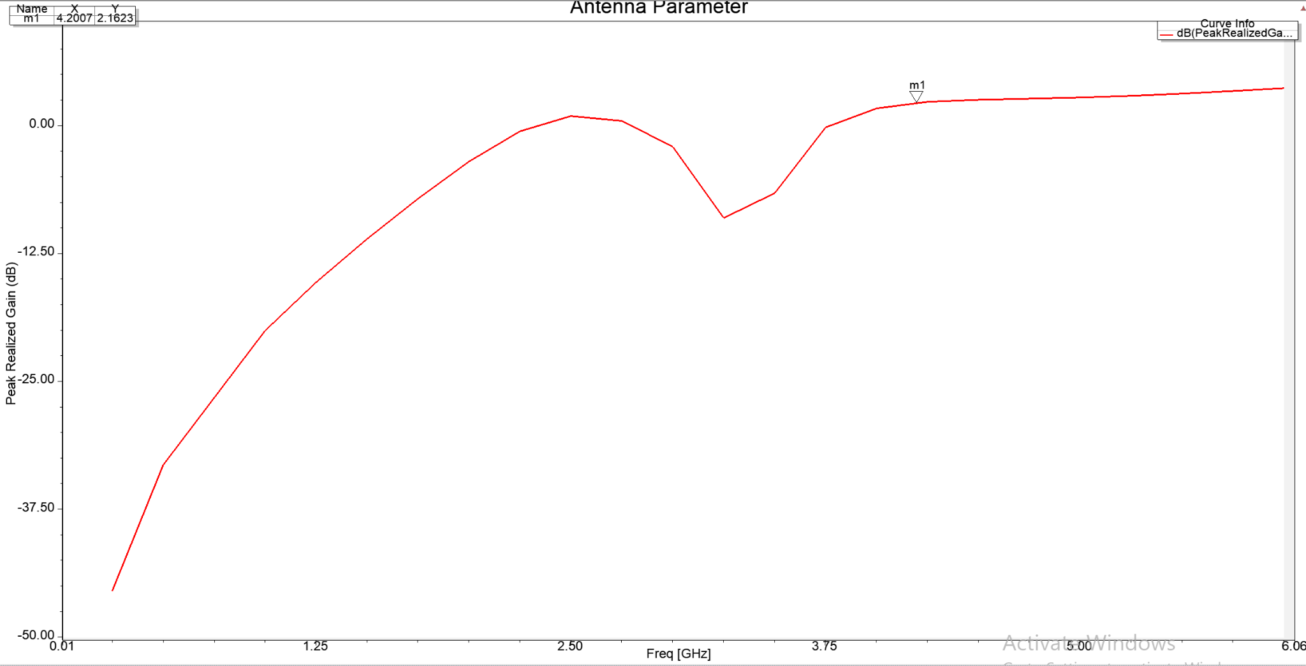
Peak Realized Gain for Single Element

Slide 15
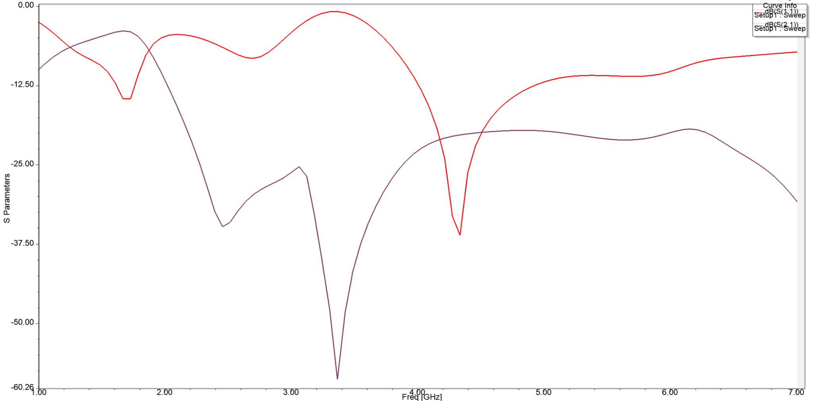
S11 & S21 Parameter

Slide 16
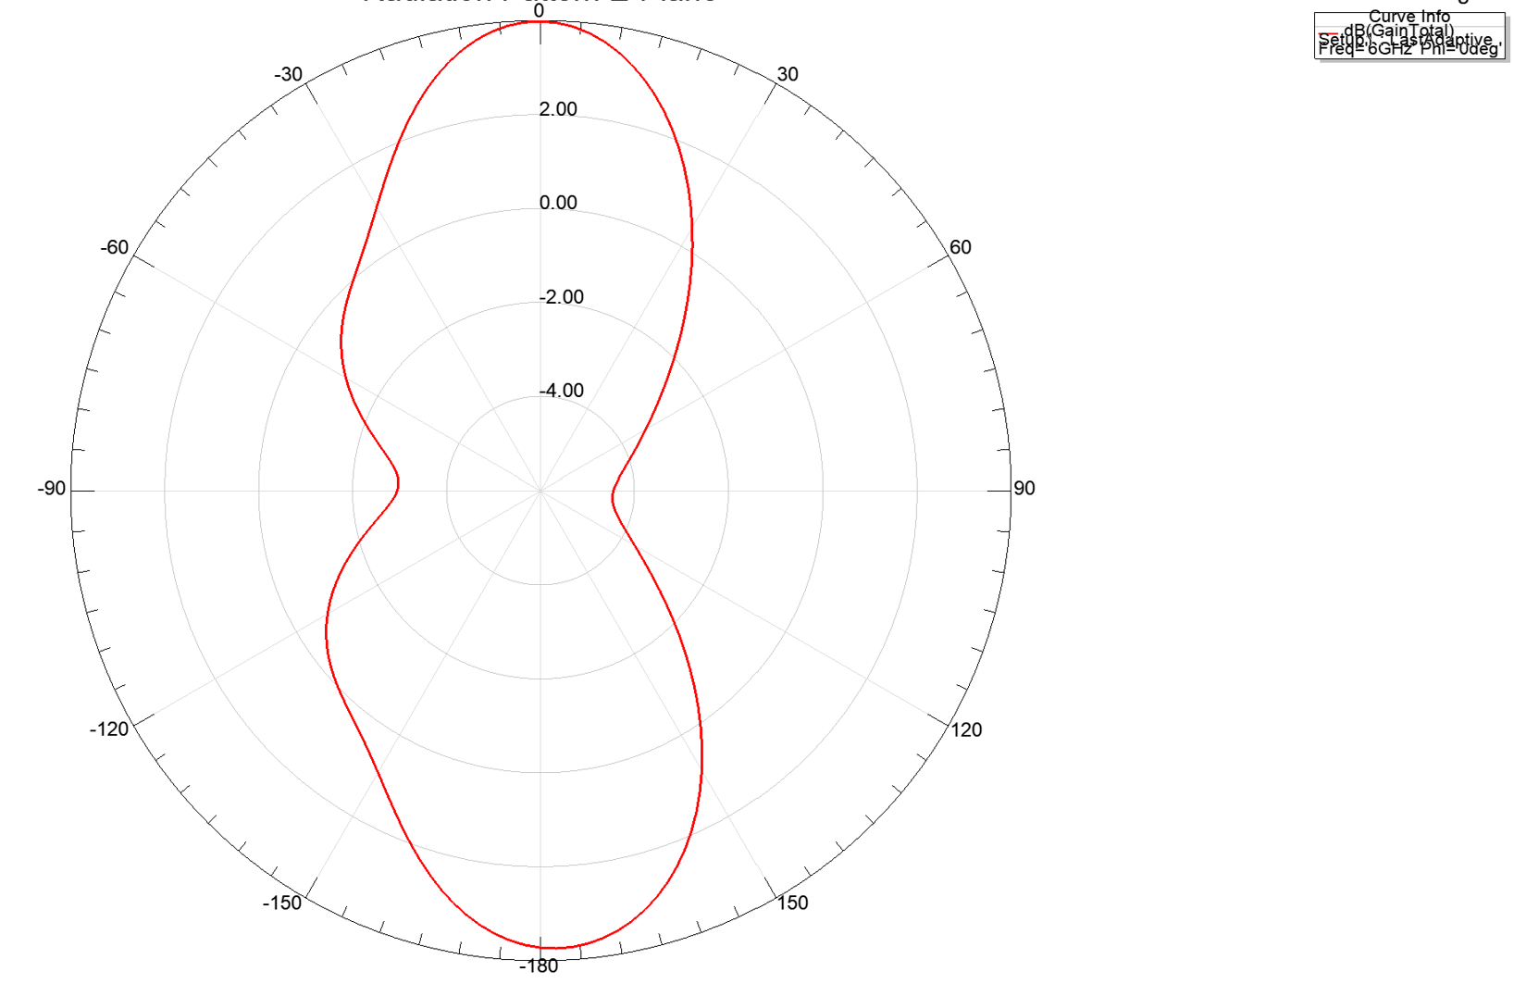
Radiation Pattern E-Plane

Slide 17
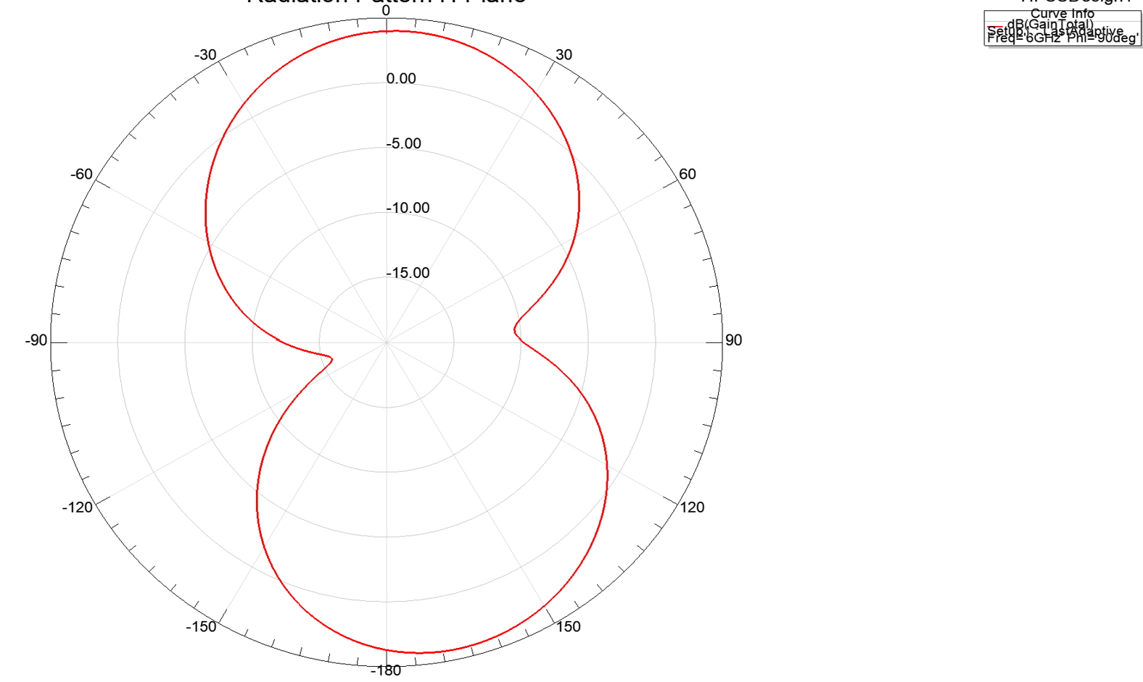
Radiation Pattern H-Plane

Slide 18
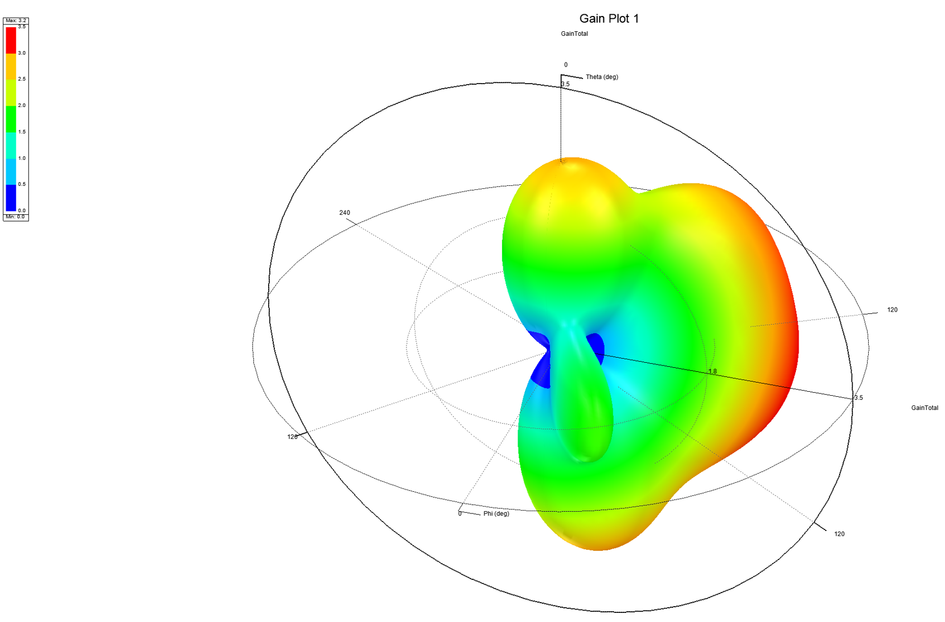
3D - Gain Plot

Slide 19
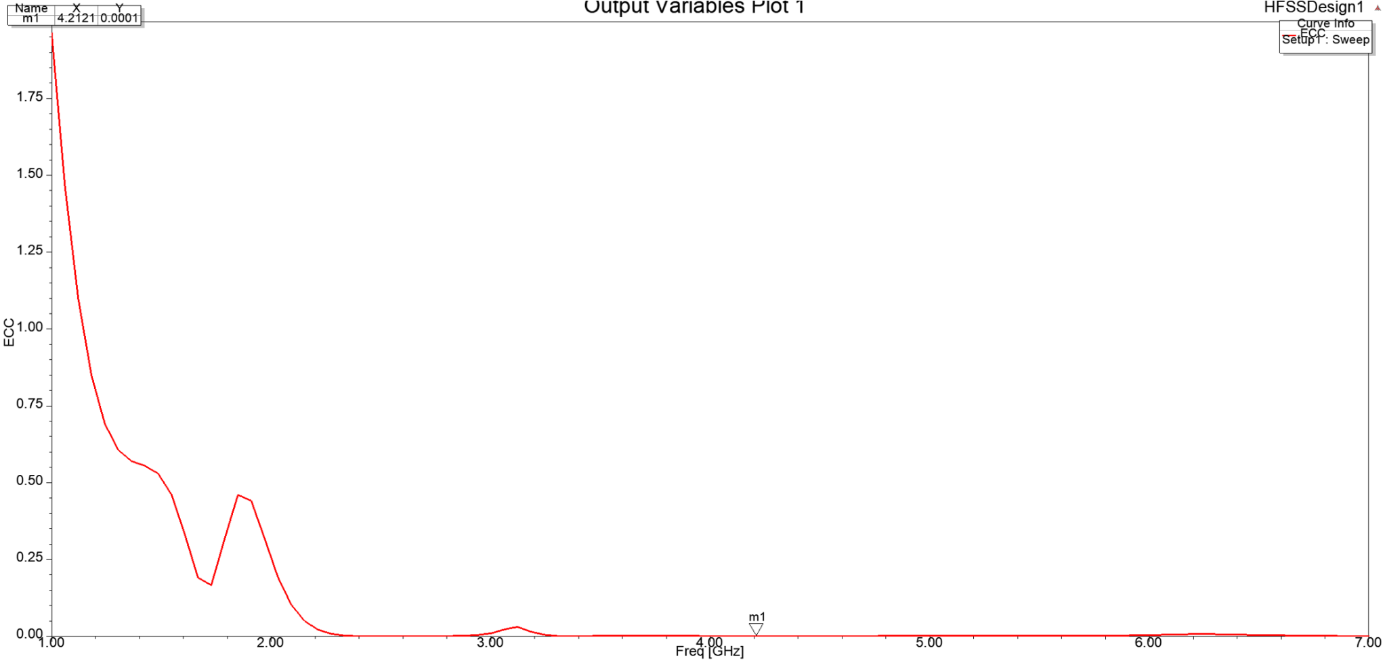
ECC

Slide 20
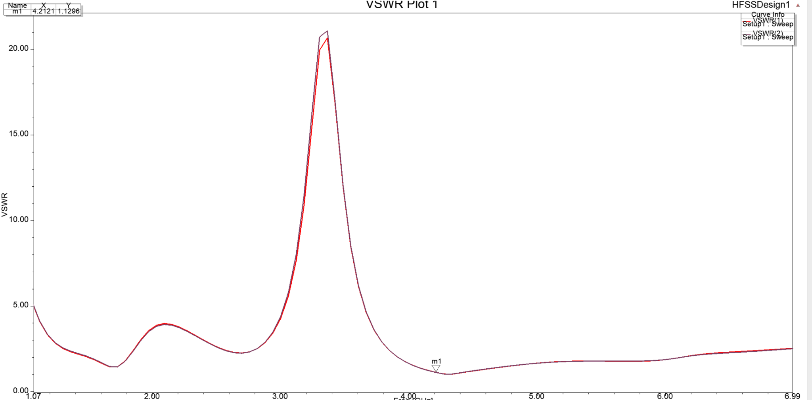
VSWR

Slide 21
COMPARISON TABLE
Ref No. | Area | Frequency Band | Gain | Isolation | ECC
[1] | 140x135 | 3.5 5.8 | 7.66 7.84 | - | 0.02
[2] | 40x40 | 3.2 5.75 | 9 | >22 | <0.05
[3] | 160x70 | 5.6-5.67 | 2.4 | >30 | 0.02
[4] | 60x60 | 3.4-3.8 | 4.5 | >19 | <0.12
[5] | 73.5x42 | 3.4-3.6 | 5.4 | >16 | <0.03
[7] | 120x60 | 3.33-5.66 | - | - | <0.26
Proposed Work | 60x33 | 3.9-6 | 3.9 | >21 | 0.0001

Slide 22
CONCLUSION
A space-efficient, two port MIMO radiator designed for Sub-6GHz 5G applications is proposed in this paper. The proposed design achieves broad operating bandwidth from 3.9–6 GHz together with strong port isolation (>21 dB), low correlation, and stable radiation behavior within a compact 60 × 33 mm² footprint.
Compared with related reported designs, the antenna offers an effective tradeoff between size,bandwidth, isolation, and diversity performance, with particularly strong ECC performance (ECC ≈ 0.0001). These characteristics make it a promising candidate for compact handheld 5G terminals. Future work will focus on fabrication and measurement-based validation of the proposed design.

Slide 23
REFERENCES
I. Ahmed, A. M. Ameen, A. Magdy, A. Nasser, and M. Abo-Zahhad, “A Sub-6GHz two-port crescent MIMO array antenna for 5G applications,” Electronics, vol. 14, no. 3, p. 411, 2025, doi:10.3390/electronics14030411.
A. A. Megahed, M. Abdelazim, E. H. AbdelHay, and H. Y. M. Soliman, “Sub-6GHz highly isolated wideband MIMO antenna arrays,” IEEE Access, vol. 10, pp. 19875–19889, 2022, doi:10.1109/ACCESS.2022.3150278.
J. Khan, S. Ullah, F. A. Tahir, F. Tubbal, and R. Raad, “A Sub-6GHz MIMO antenna array for 5G wireless terminals,” Electronics, vol. 10, no. 24, p. 3062, 2021, doi: 10.3390/electronics1024306.
S. Saxena, B. K. Kanaujia, S. Dwari, S. Kumar, H. C. Choi, and K. W. Kim, “Planar four-port dual circularly-polarized MIMO antenna for Sub-6GHz band,” IEEE Access, vol. 8, pp. 90779–90791, 2020, doi: 10.1109/ACCESS.2020.2993897.
S. N. R. Rizvi, M. Abu Sufian, W. A. Awan, Y. Choi, N. Hussain, and
N. Kim, “A closely spaced two-port MIMO antenna with a radiation null for out-of-band suppressions for 5G Sub-6GHz applications,” PLoS ONE, vol. 19, no.7, p.e0306446, 2024, doi:10.1371/journal.pone.0306446.
Compact two-port MIMO antenna supporting the Sub-6 GHz 5G spectrum band of n77-n78. 978-1-6654-8035-2/22/$31.00 ©2022 IEEE | DOI: 10.1109/ICCCI54379.2022.9740767

Slide 24
S. Padmanathan et al., “Compact multiband reconfigurable MIMO antenna for Sub-6GHz 5G mobile terminal,” IEEE Access, vol. 10, pp. 60241–60252, 2022, doi: 10.1109/ACCESS.2022.3180048.
P. Singh et al., 'Compact Dual-Band MIMO Antenna for WLAN/WiMAX Applications,' IEEE Trans. Antennas Propag., 2022.
R. Sharma et al., 'Isolation Enhancement in MIMO Antennas Using Defected Ground Structure,' IEEE Access, 2021.
M. Kumar et al., 'Multiband Microstrip Patch Antenna Design Using Slot Structures,' IET Microwaves, Antennas & Propagation, 2020.
A. Yadav et al., 'Triple Band Microstrip Antenna Using Parasitic Coupling,' IJAREEIE, 2020.

Slide 25


